Slide 1
Fuzzing QR CODE GENERATOR
Midterm Presentation
Hector Acosta - 2022427831

Slide 2
MOTIVATION + Objective
Target domain: Artifitial inteligence
Incentive: Is an important tool for AI and data science
Importance: A significant proportion of AI projects makes use of Pandas supported by prominent companies
Objectives: Identify defects and enhance efficiency
Notes:
pandas is an important tool for AI and data science in general. It is a Python library that provides high-performance data manipulation and analysis tools for structured data. Some of the main features of pandas include:
Data manipulation
Data analysis
Data visualization
Data integration
In AI, pandas is often used for data preprocessing and data cleaning, which are important steps in the data pipeline. Data scientists and machine learning engineers use pandas to load, clean, and transform data into a format suitable for building and training AI models. Overall, pandas is an essential tool for anyone working with structured data in Python.

Slide 3






Target System
Notes:
pandas is an important tool for AI and data science in general. It is a Python library that provides high-performance data manipulation and analysis tools for structured data. Some of the main features of pandas include:
Data manipulation
Data analysis
Data visualization
Data integration
In AI, pandas is often used for data preprocessing and data cleaning, which are important steps in the data pipeline. Data scientists and machine learning engineers use pandas to load, clean, and transform data into a format suitable for building and training AI models. Overall, pandas is an essential tool for anyone working with structured data in Python.

Slide 4
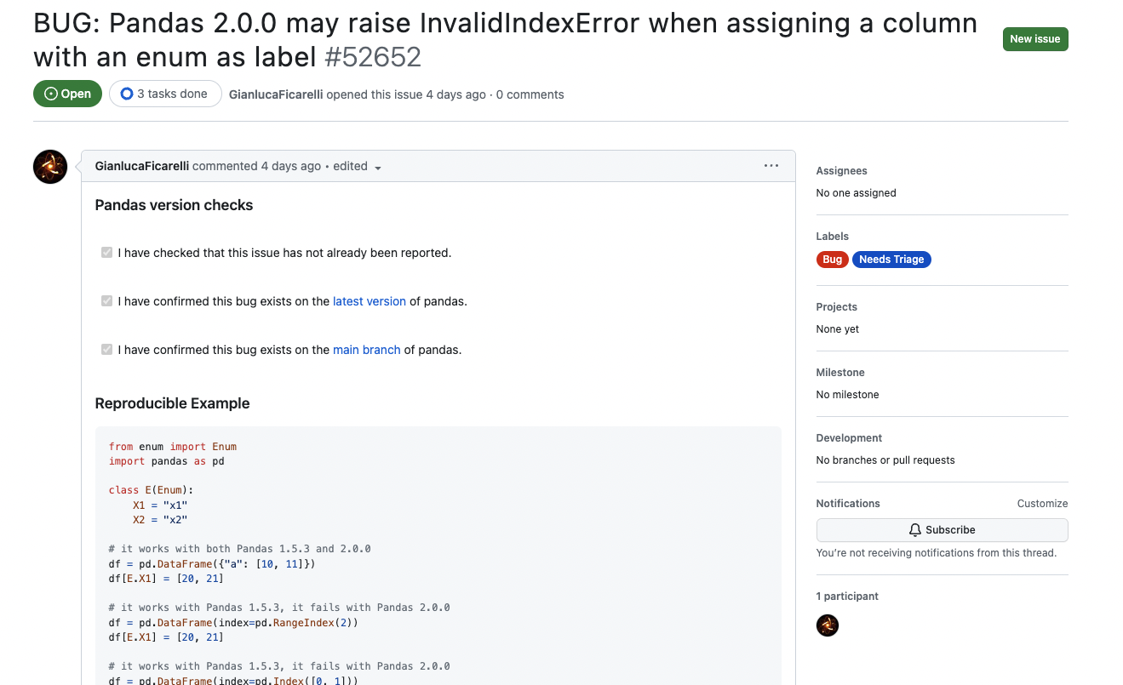

Example of bug 1
Source: GitHub Pandas Repository Issues
Basic Description: Pandas crashes with InvalidIndexError when assigning a column with an Enum as label
Expected behavior: The code should create a DataFrameObject as usual given that is one of its described functionalities
Issue URL: https://github.com/pandas-dev/pandas/issues/52652

Slide 5
Issue 1 explanation
Current behavior
Expected behavior
from enum import Enum
import pandas as pd
class E(Enum):
X1 = "x1"
X2 = "x2"
df = pd.DataFrame(index=pd.RangeIndex(2))
df[E.X1] = [20, 21]
from enum import Enum
import pandas as pd
class E(Enum):
X1 = "x1"
X2 = "x2"
df = pd.DataFrame(index=pd.RangeIndex(2))
df[E.X1] = [20, 21]
pandas.errors.InvalidIndexError: E.X1
{"a": [10, 11], "x1": [20, 21]}

Slide 6
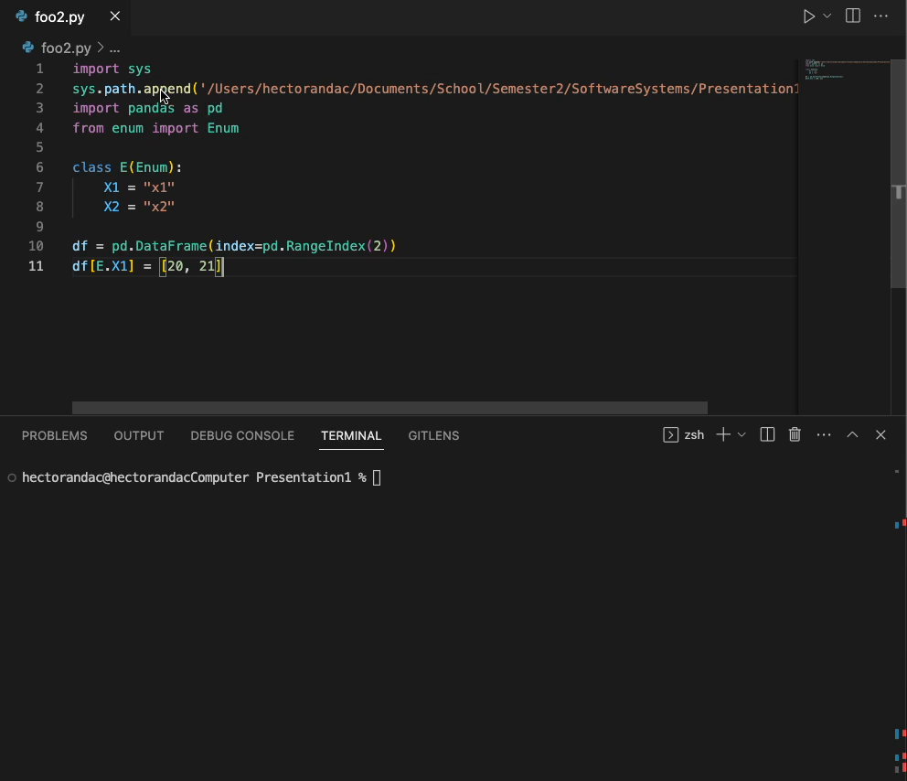
Reproducing the issue 1

Slide 7
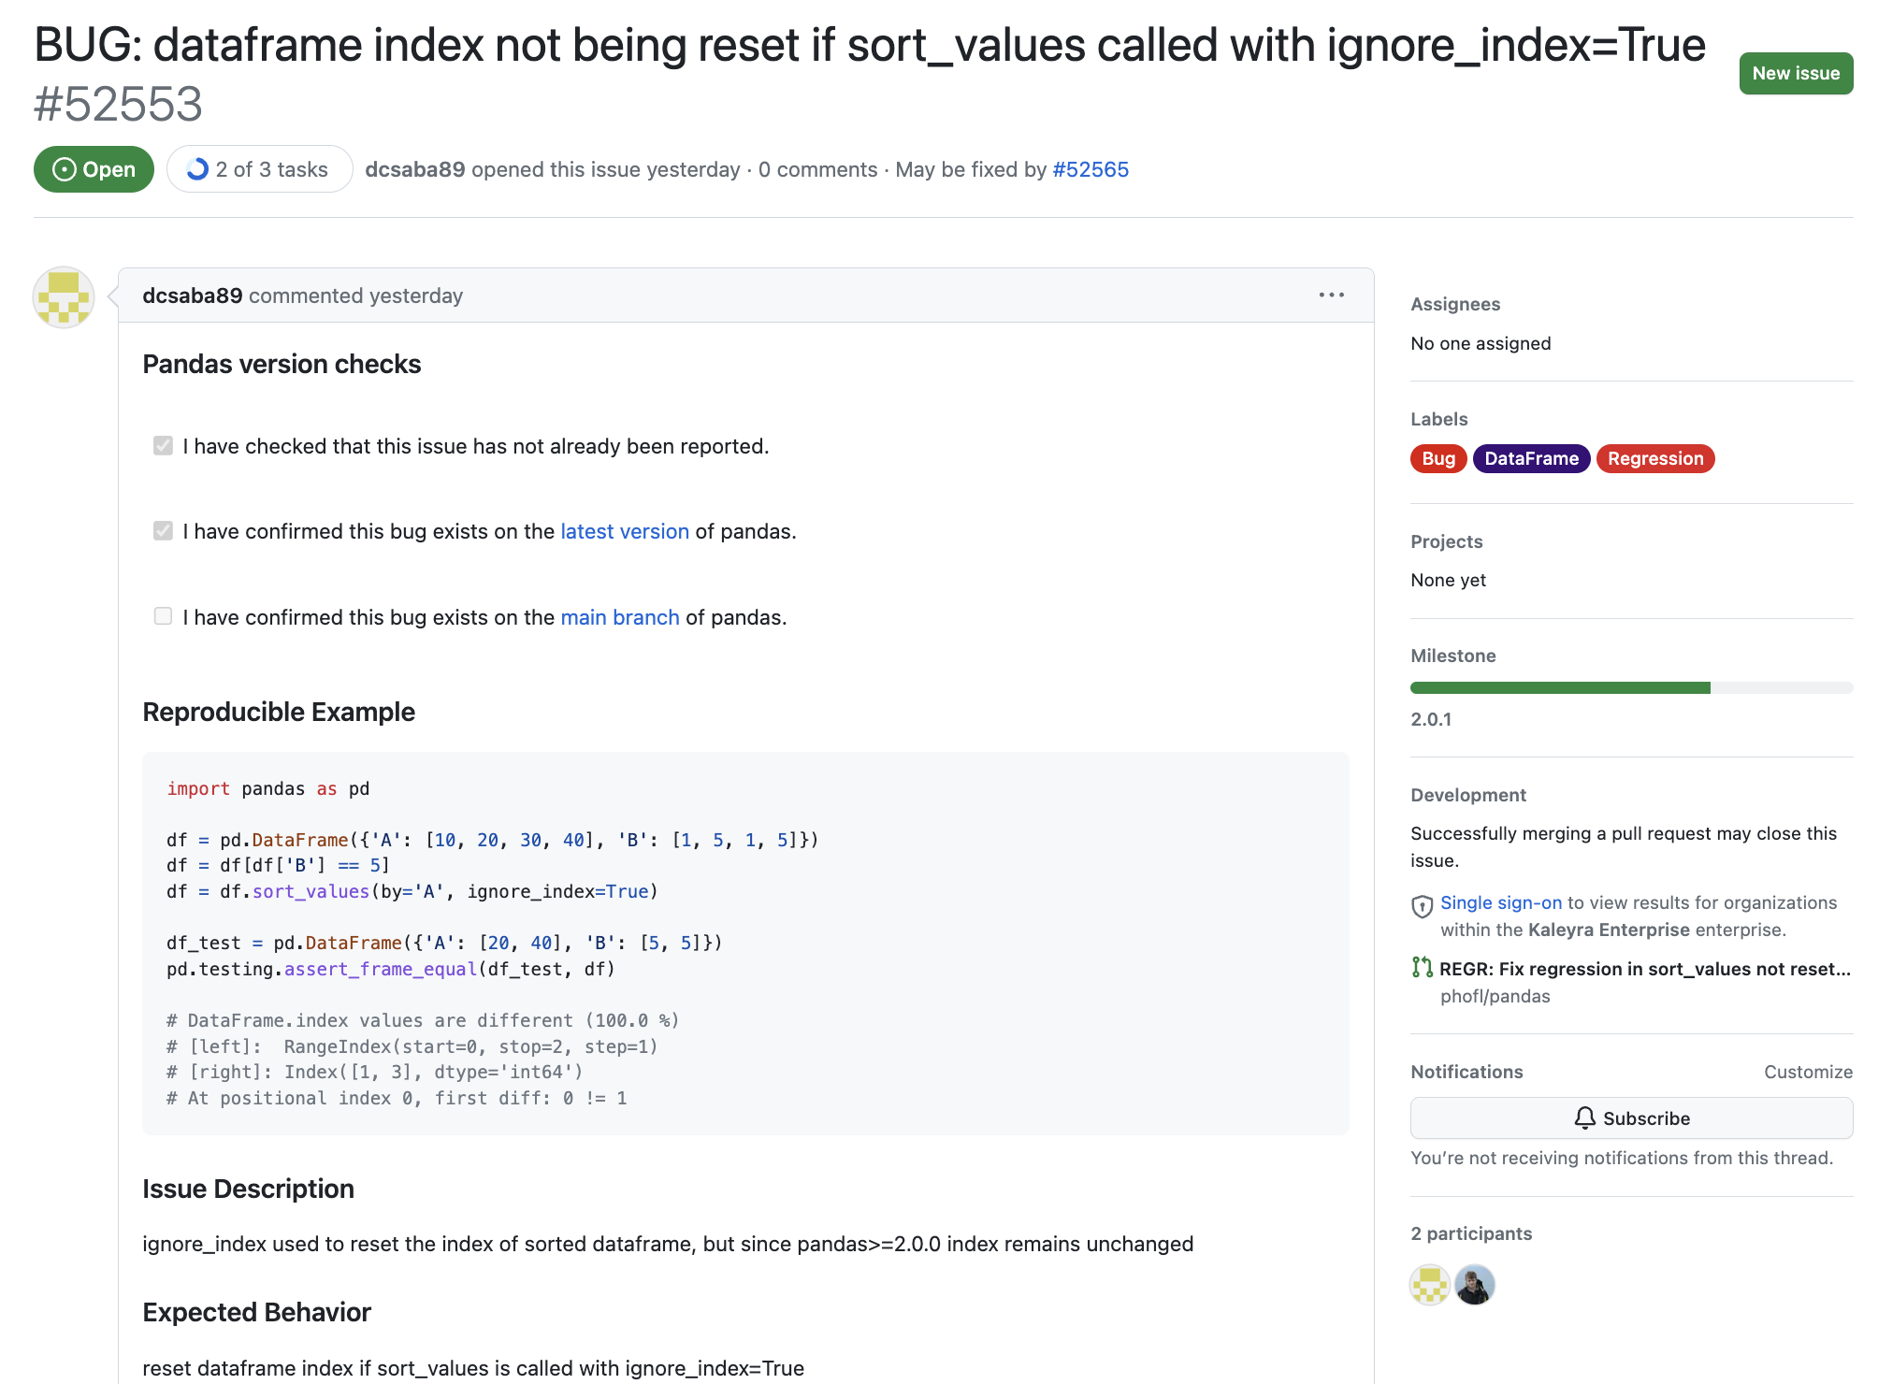
Example of bug 2
Source: GitHub Pandas Repository Issues
Basic Description: ignore_index used to reset the index of sorted DataFrame, but since Pandas’ version 2.0.0 and greater the index remains unchanged.
Expected behavior: reset dataframe index if sort_values is called with ignore_index=True
Issue URL: https://github.com/pandas-dev/pandas/issues/52553

Slide 8
Issue 2 explanation
Data Frame Object
 | Name | Age
0 | Jhon | 30
1 | Jane | 25
2 | Bob | 40
Data Frame Object
 | Name | Age
1 | Jane | 25
0 | John | 30
2 | Bob | 40
df.sort_values(by='Age')
df.sort_values(by='Age', ignore_index=True)
Data Frame Object
 | Name | Age
0 | Jane | 25
1 | John | 30
2 | Bob | 40
Data Frame Object
 | Name | Age
1 | Jane | 25
0 | John | 30
2 | Bob | 40

Slide 9
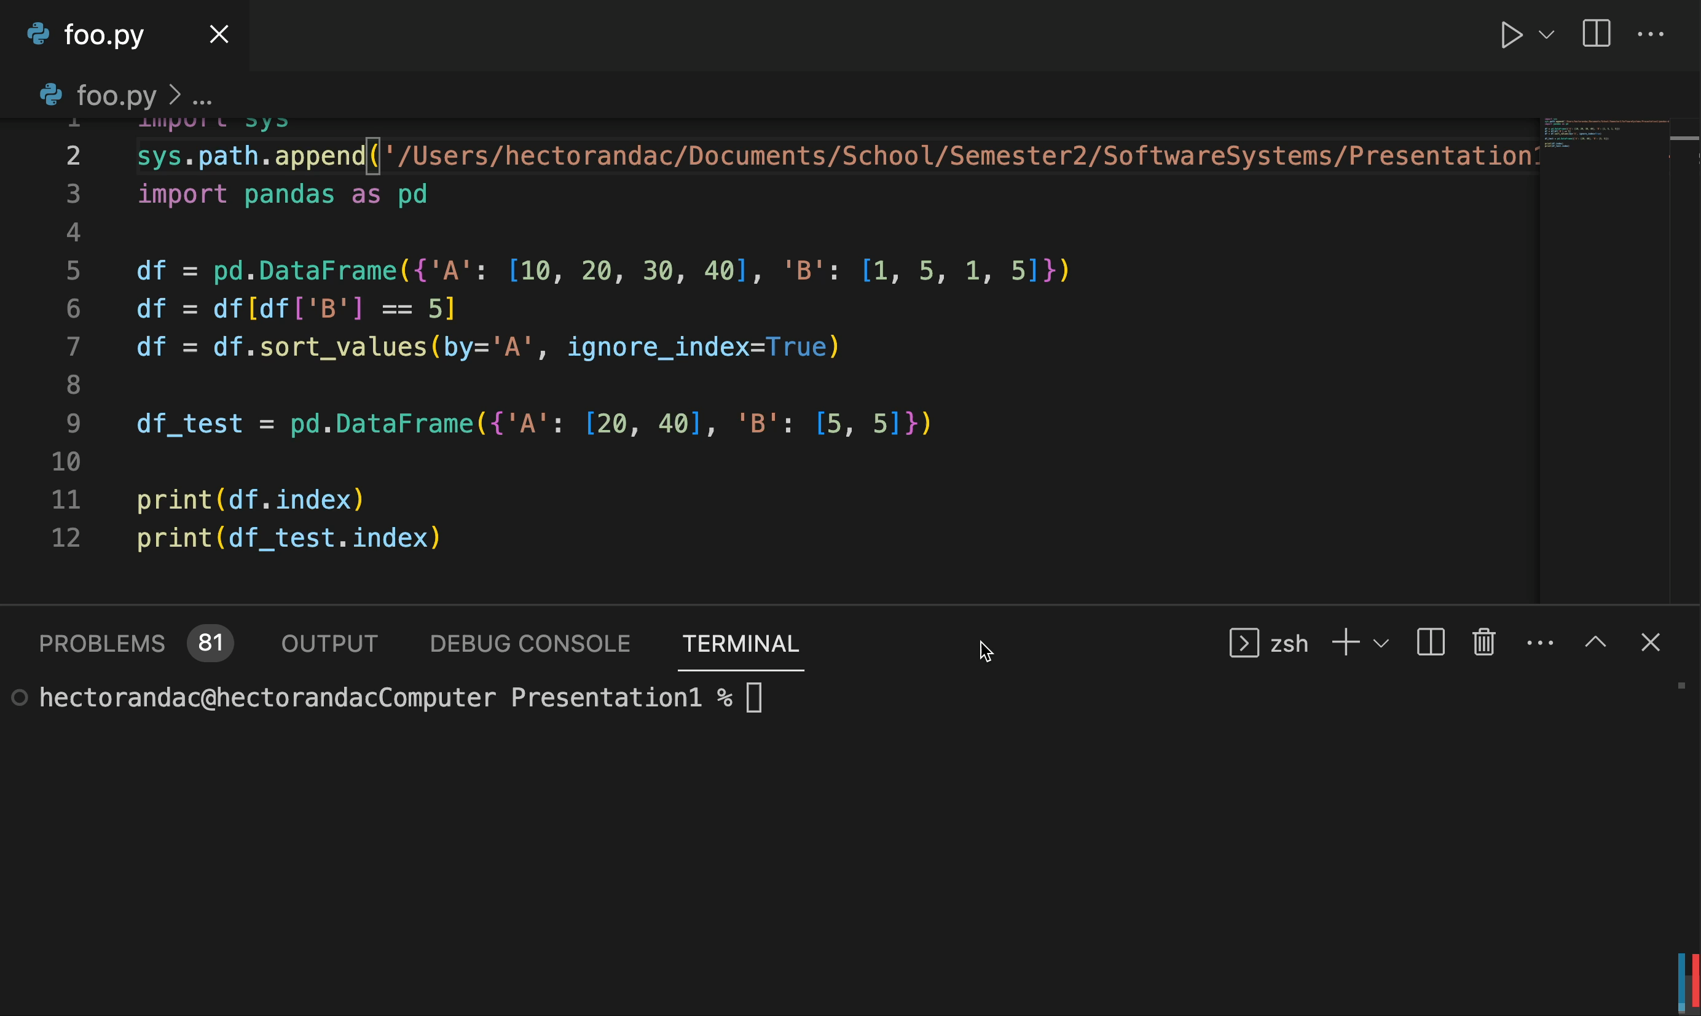
Reproducing the issue 2
import pandas as pd
df = pd.DataFrame({'A': [10, 20, 30, 40], 'B': [1, 5, 1, 5]})
df = df[df['B'] == 5]
df = df.sort_values(by='A', ignore_index=True)
df_t = pd.DataFrame({'A': [20, 40], 'B': [5, 5]})
print(df.index)
print(df_t.index)

Slide 10
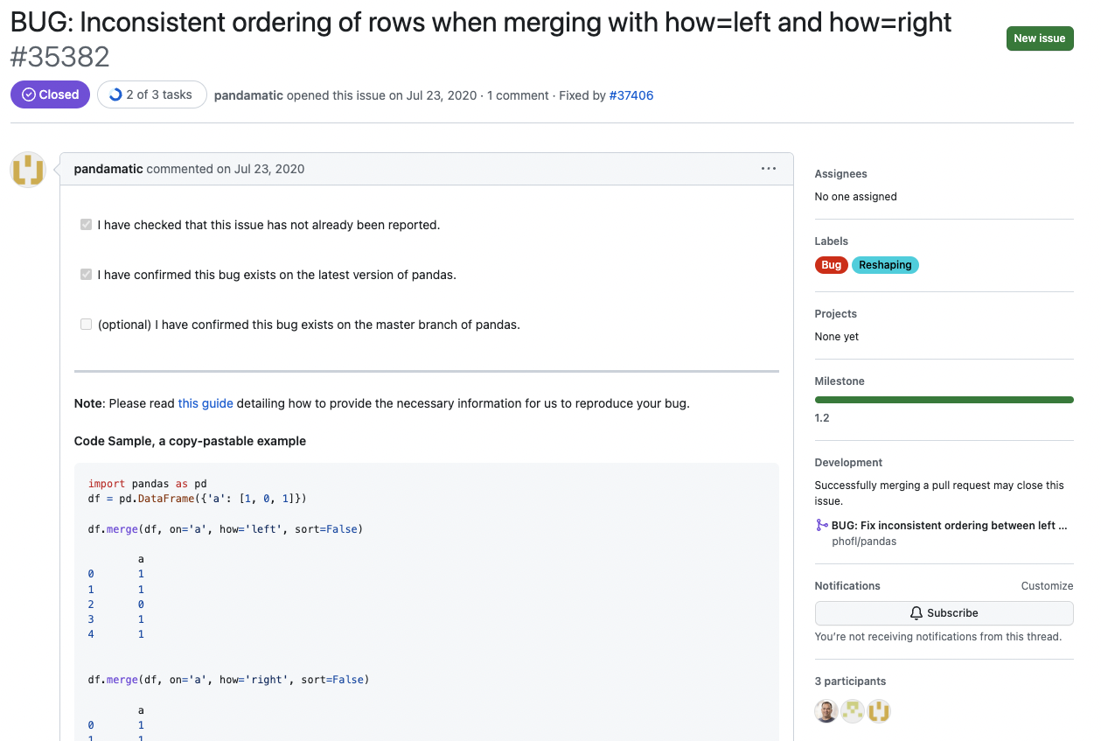
Example of bug 3
Source: GitHub Pandas Repository Issues
Basic Description: Inconsistent ordering of rows when merging with how=left and how=right
Expected behavior: During merge if the input is similar, during merge the output should also be similar regardless of the merge ordering method.
Issue URL: https://github.com/pandas-dev/pandas/issues/35382

Slide 11
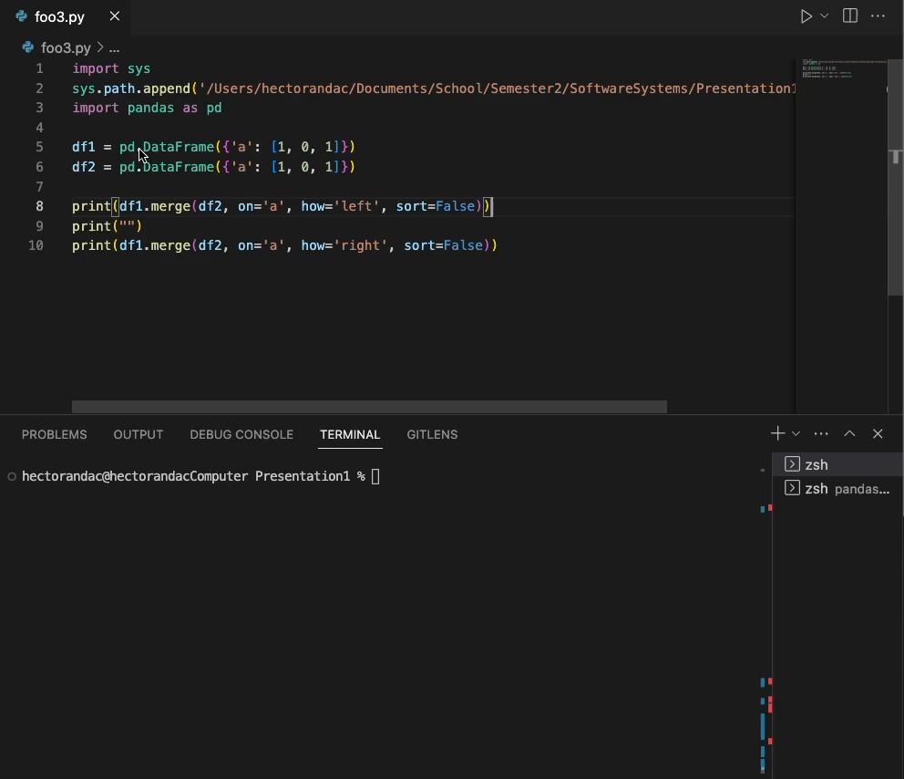
Reproducing the issue 3
import pandas as pd
df1 = pd.DataFrame({'a': [1, 0, 1]})
df2 = pd.DataFrame({'a': [1, 0, 1]})
print(df1.merge(df2, on='a', how='left', sort=False))
a
0 1
1 1
2 0
3 1
4 1 print("")
print(df1.merge(df2, on='a', how='right', sort=False))
a
0 1
1 1
2 1
3 1
4 0

Slide 12
Fuzzing Architecture Description
Automate the creation of random Data Frame Objects and applying structured sorting or merging operations
Randomize number of elements
Randomize number of columns to include multiple columns
Randomize the values filling the slots on the Data Frame Object
Randomize the datatype representing the labels
Vary the size and the complexity of the inputs in order to test the limits.
Presence of missing values and anomalies
Varying number of rows and columns
Varying Data Types

Slide 13
Fuzzing Architecture Description
Use of mutation-based Fuzzing
Small changes to the input Data Frame (Swapping columns, Individual value changes)
Multiple Pandas versions test
Spot new issues
Spot regression

Slide 14
Metrics to be avaluated
Bug discovery rate
Mutation score
Diversity of input
Resource utilization (Speed)

Slide 15

Fuzzing pandas – Thanks for your attention
Hector Acosta - 2022427831

